Slide 1
ESDC Integrity Hackathon 2021
UBC Team 13
Asma Al-Odaini, Rachel Wong, Lara Habashy, Simon Zheng, Javairia Raza

Slide 2
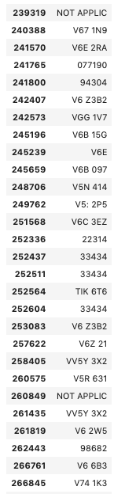
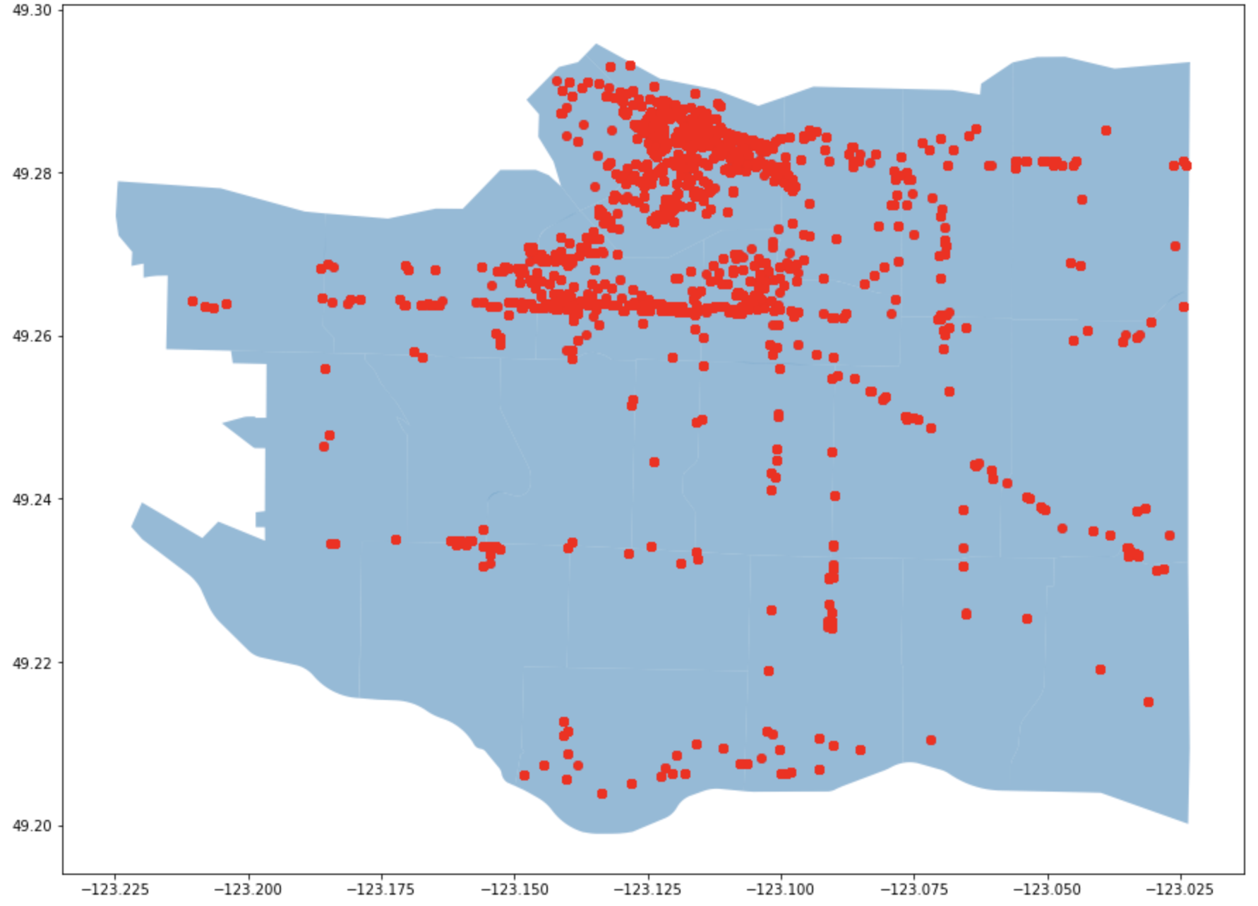
Exploring the Data
Some anomalies (Ex. huge employee increase)
Some postal codes are mistyped
Non-Canadian cities found with country listed as Canada
Possibility to verify mismatch in province/ city/ postal code
Some missing addresses
Longitude and latitude are all found within the BC area
Some business names can be replaced by business trade name for searching purposes.
Notes:
Asma

Slide 3

Ideas and Purpose
Business names from the existing data set
Ngrams - minimum 3 letter search
Keyword searches - “enterprise”, “ltd”, “inc” , etc
Missing address scraped from Google (Beautiful Soup)
Two final products:
1. robust data repository and,
2. a dashboard for a user friendly experience

Slide 4
Scraping Approaches
Scraping process:
Canadianbusinessregistries.ca (API)
Google.com (BeautifulSoup Python)
Opengovca.com (BeautifulSoup Python)
Limitations:
14+ hours
Varying information on different sites
Notes:
Simon
Firstly, we use the company names we have from the dataset (business-license-hackathon) as keywords to scrape on Canadian Business Registries website for more details. The benefit of doing this is that when we search for a particular company name, there are always some related other companies have same keywords will be scraped from Canadian Business Registries, that enriches our dataset.
The downside of Canadian Business Registries is that it does not contain detailed address for companies, it only has the provinces and cities. So we have to do another scraping on Google, to search for the address. But there are a number of cases that we can not fetch a proper addresses from Google either. For example the company like Amazon, it has many children company and it has offices everywhere, scraping will not know to keep which one. Or some companies are just too small to find a clue on the Internet. Or some companies they have very similar names but probably on completely different fields and physical places.
Asma did a scraping on Opengovca.com using BeautifulSoup as well, and she realized that the data this website has is pretty much similar to what we have so far, nothing new really. Therefore, we did not do further investigation on this website.
There are definitely some limitations. The biggest one is the time, which is fair to everybody who is participating on this hackathon. In order to avoid web page error which causes by frequently sending requests for scraping, we have to set a sleep time when we send a request to a web, so the code won’t die. This will make the whole process very long.
The other difficulty is that different websites, in their api or json files, they have different names for some same attributes. For example, a attribute called “registry_id” could be called as “Juri_id” or “business id” on other websites, but we also have a very important attribute called “business number”. So it is really confusing sometime .

Slide 5
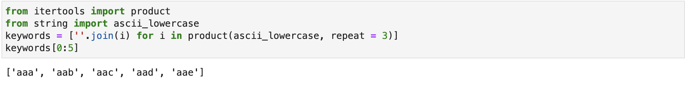
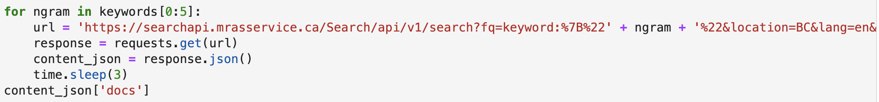
Implementing 3-gram Scraping
Notes:
Rachel
Showing a demo of a slice of ngrams since it wouldve taken 14 hours to do all the ngrams (over 17,000 ngrams with 3 second sleep)
3 letters (minimum search requirement), can search through the entire database using these ngrams but is quite slow
When we ran through list of tri-grams by adding the specific ngram into the URL to request
We needed to add a 3 second sleep period after each request because we ran into errors on the web page when scraping too fast
Ended up in running for 14+ hours so we didn’t end up using this method, but an example slice here shows the potential for this methodology
Scrape the data and return output

Slide 6
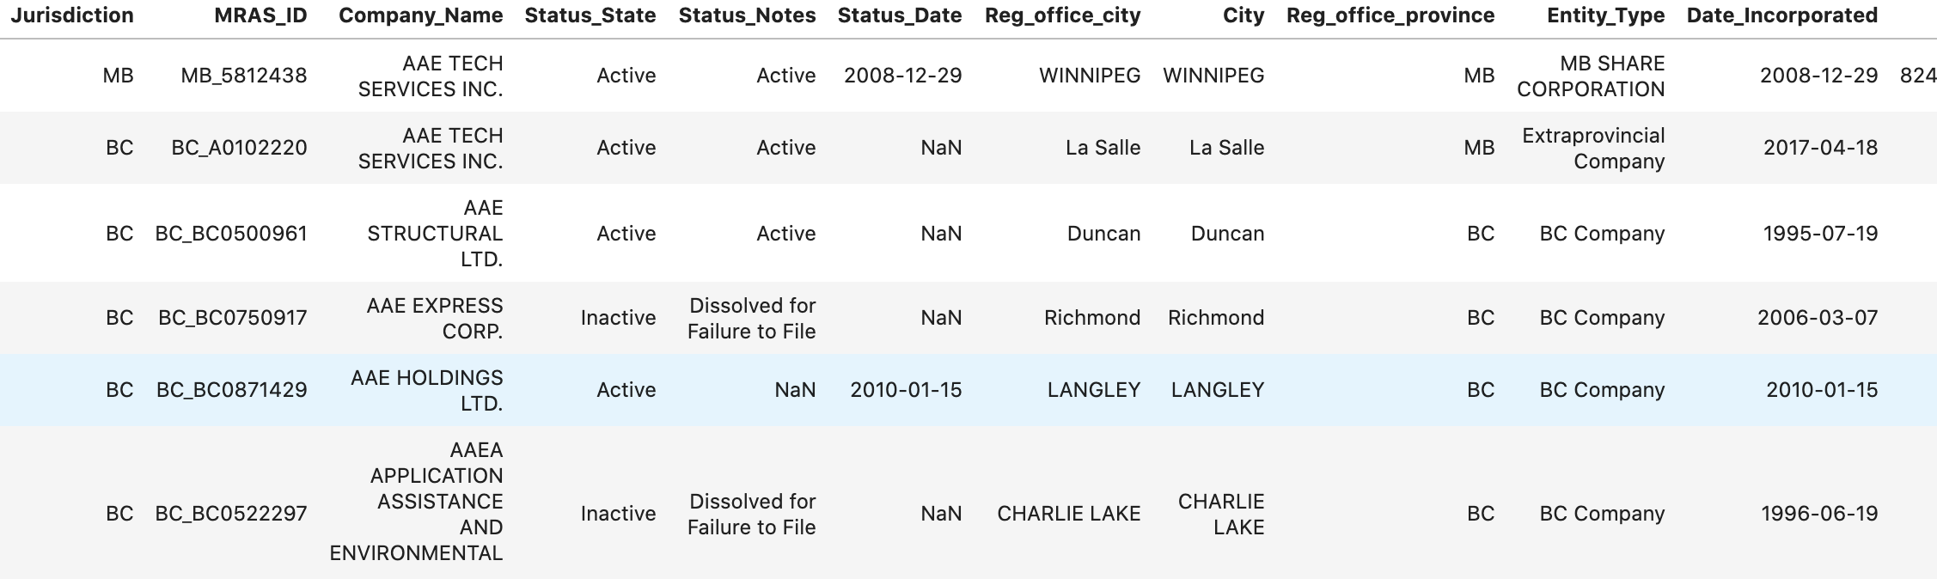
3-gram Scraping Dataframe
Notes:
Rachel
This is what we could have had, but it wasn’t in the stars
Slice of ngrams
Converted output to a dataframe and we can see that
Output contains company names, locations, business status, and more
Helpful for determining if a business is legitimate and comparing against the current dataset we have

Slide 7
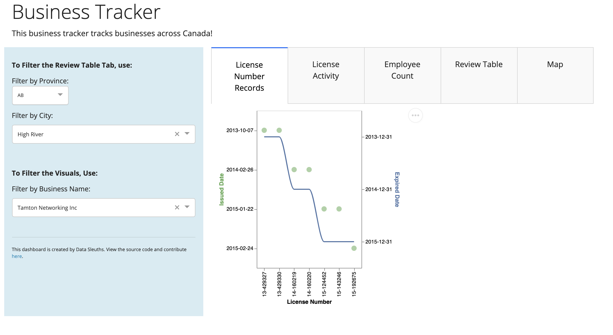
Dashboard
Live Demo
Notes:
Three examples to showcase: normal (Gyoza Bar Ltd), anomaly (Tamton Networking Inc), anomaly 2 (Lifestyle Beauty Inc)
To showcase review table, use Province: BC - City: Vancouver with filter keyword security
Geospatial data analysis showed that all of the businesses were in very close proximity to each other, and the map couldn’t zoom in close enough
Plot 1: License number records
Looks at - comparing issue dates and expiry dates for multiple licenses over time
The x axis is Licence numbers - which is sorted by year - 13, 14, 15
Plot 2: Days Active per Year - shows how many days each license was active for, for a given business name.
Plot 3: Employee plot

Slide 8
Thank you for your time!

Slide 9
The Pitch!
Our dashboard allows investigators to view license number records for a specific business which could help then identify businesses with multiple license numbers in different years. They can also view the number of days a business had an active license across multiple years. It also allows them to compare employee numbers across the years to help detect anomalies.
In addition, the investigator can filter the dataset by provinces and cities to browse the data for that area and select features to view.

